Slide 1



Joined-Up Thinking: Social Enterprise, Research and the Curriculum in Today’s Global World
Dr Jamie Halsall, Dr Roopinder Oberoi and
Dr Michael Snowden

Slide 2
Layout of Session
Introduction
A Note on Methodology: This Research
Framing Social Enterprise
Governance
Globalisation and Social Policy
The Curriculum
Examples of Social Enterprises in the UK
Key Findings
Best Practice
Mentoring
Concluding Thoughts
Key Questions

Slide 3
Introduction
Societal changes
  economic, social, political and cultural contexts
The importance of institutions
  International, governmental and community
Institutions have formed the bedrock of society
Support mechanism for different social groups
“….institutions are the formal and informal rules and practices which impact the economic behaviour of individuals and organisations, the economies of nation-states, and economic life at the international level.”
(Duina, 2011, p. 24)

Slide 4
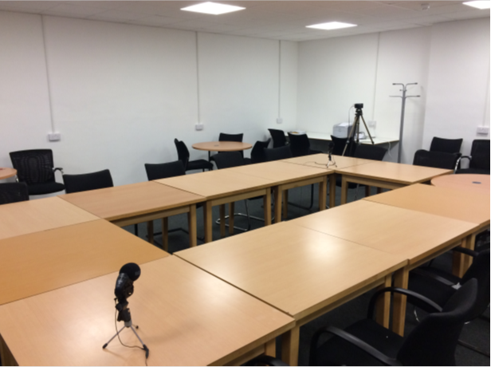
A Note on
Methodology
Case study examples
Qualitative research element:
  Focus Groups and Semi-Structured Interviews
The recruitment process
  Gatekeepers
Ethical process
  Information Sheet and Consent Form
Thematic Analysis (Themes from findings)

Slide 5
Framing Social Enterprise
Social enterprise has become an increasingly important factor in societal issues
  See the work of: Sinclair, et al., 2018; Park, et al., 2017; Moizer and Tracey, 2010.
Social enterprise - there is no common agreement
International context:
  Sustainable Development Goals
  See the work of: Oberoi, Halsall and Snowden (2019)
Defourny (2001) clear standards that an individual can follow
  The Four criteria

Slide 6
Framing Social Enterprise
A social enterprise is:
  “a business venture that brings people and communities together for economic development and social gain. Because it is a business, it is expected to generate a surplus and that surplus is to be for the benefit of the community that it serves.”
(Martin and Thompson, 2010, p. 13)

Slide 7


The 2030 Agenda for Sustainable Development
September 2015
  “shared blueprint for peace and prosperity for people and the planet, now and into the future”
  “an urgent call for action by all countries - developed and developing - in a global partnership” (UN, 2019)
Seventeen Sustainable Development Goals
  Enact and create a cohesive global partnership

Slide 8
Global Governance
“….global governance implies change in what states are and what they can do as new ways of making decisions and acting on collective problems that develop.”
International community
Institutions working together
  UN, Governments, NGOs, Social Enterprise, Private Sector
To stop global uncertainty
(Sinclair, 2012, p. 1)

Slide 9
Globalisation and Social Policy
“Social policy is a key area in which the politics of globalisation are fought out.”
How does global capitalism currently differ from previous periods?
What are the implications for governments, employers, workers, communities, families, households and individuals?
(Yeates, 2001, p. 1)

Slide 10
Globalisation and Social Policy
Traditionally, social policy is mainly focussed on a national context.
Globalisation has caused nations to think globally.
Yeates (2001, p. 17)has long argued that globalisation in a social policy context creates “uneven development and geo-economic inequality.”

Slide 11

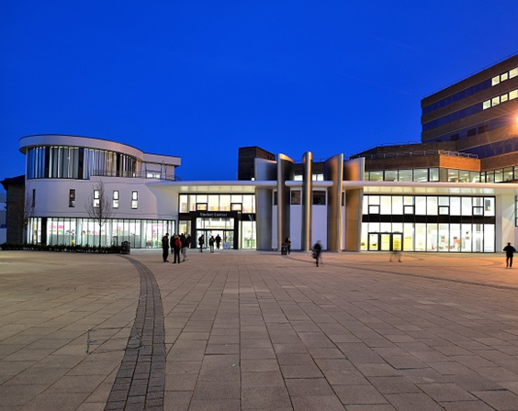
The Curriculum
Module based
  Heutagogical approach to teaching and learning
Research led
  Student to undertake a research project
  Supervised
  Impact on society
Transferable skills
  Working in the sector
  Setting up a social enterprise

Slide 12
Examples of Social Enterprises in the UK
Kibble Education and Care Centre
  Purpose: to support children and young people who are regarded to be at risk.
Social Bite
  Purpose: to provide housing for people who are homeless.
The Wise Group
  Purpose: to deliver services in three areas: employability and skills, sustainability, and community justice.
(Oberoi and Halsall, 2019)

Slide 13
Key Findings (1)
Social Enterprise: Defining the Term
“…it’s business that has some kind of social benefit or social good or environmental benefit.”
“A business that helps support the local community, as well as making money for itself, sort of.”
(Focus Group Meetings, 2018)

Slide 14
Key Findings (2)
Community Involvement
“I think it’s about partnerships really, with businesses, partnerships with charities, partnerships with the retail centre …”
“I think people, well the Social Enterprise Sector as a whole is not good at marketing itself…”
(Focus Group Meetings, 2018)

Slide 15
Key Findings (3)
Government Support
“Some of us were having these debates twenty five years ago and we spent a long time talking to Government Ministers about the fact that how much money they would safe…”
“There’s a Minister for Civil Society, [Name]. [Name] does have an interest in Social Enterprise. What, I mean what do Central Government do? I don’t know, I’m similar, I don’t know, but have they put their money where their mouth is? Is the money coming? They must be somewhere mustn’t they, or is it, is it meaningful, is it tokenistic? I don’t know.”
(Focus Group Meetings, 2018)

Slide 16
Key Findings (4)
Universities and Social Enterprise
“University is, you know, its got the links with employers, its got the, its got the intelligence to know where the growth jobs are, the jobs of the future are.”
“We’ve worked with, in different roles, but with different universities, some of it […]was [Name of University] and it was their sort of link in with industry type thing but it was about higher education links…”
(Focus Group Meetings, 2018)

Slide 17
Source: (Halsall and Powell, 2016, p. 3)
Figure 1: Knowledge Exchange.

Slide 18
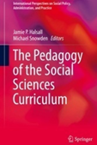

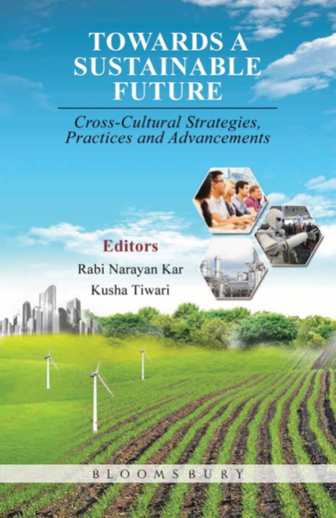
Developing Best Practice
Best Practice
  Evidence based research
  Offers different approach
Applied in different ways:
  Society
  Organisations
  Students
Models to explain in easy ways

Slide 19
Source: (Oberoi, et al., 2019, p. 8)
Figure 2: A Model for Social Enterprise.

Slide 20
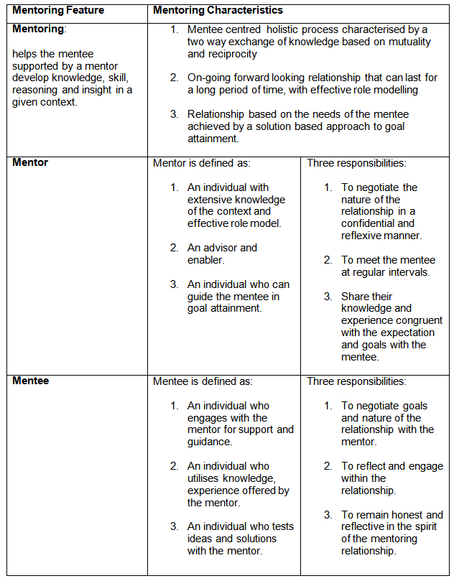
Figure 3: The Importance of Mentorship.

Slide 21


Concluding Thoughts (1)
Social enterprise is a key component in tackling societal and economic challenges
New emphasis on the relationship between the public sector and local communities
Clear international context
Applied best practice examples

Slide 22
Concluding Thoughts (2)
Future research opportunities for us to think about:
  Closer research collaboration
  Further development of social enterprise in higher education
  Global links: China, India and U.K.
    Social enterprise and social value creation

Slide 23
References
Defourny, J. (2001) ‘Introduction: From Third Sector to Social Enterprise’, In C. Borzaga and J. Defourny (Eds.) The Emergence of Social Enterprise, London: Routledge, pp. 1-28.
Duina, F. (2011) Institutions and the Economy, Cambridge: Polity Press.
Halsall, J. P. and Powell, J. L. (2016) ‘Crafting Knowledge Exchange in the Social Science Agenda’, Cogent Social Sciences, 2, pp. 1-6, ISSN: 2331-1886.
Moizer, J. and Tracey, P. (2010) ‘Strategy Making in Social Enterprise: The Role of Resource Allocation and Its Effects on Organizational Sustainability’, Systems Research and Behavioral Science, Vol. 27, pp. 252-266.
Oberoi, R., Halsall, J. P. and Snowden, M. (2019a) ‘Mapping the Role of Social Enterprise: A Sustainable Model for Future?’, In R. Narayan Kar and K. Tiwari (Eds.) Towards a Sustainable Future: Cross-cultural Strategies, Practices and Advancements, London: Bloomsbury Publishing, pp. 89 -108.
Oberoi, R. and Halsall, J. P. (2019) ‘Social Enterprise as Catalyst for Change: Case Study of India and UK’, In S. Seifi and D. Crowther (Eds.) Approaches to Global Sustainability, Markets, and Governance, Springer: New York, Chapter 15, pp.231-224.
Park, C., Lee, J. and Wilding, M. (2017) ‘Distorted Policy Transfer?: South Korea’s Adaptation of UK Social Enterprise Policy’, Policy Studies, Vol. 38(1), pp. 39-58.
Sinclair, S., Mazzei, M., Baglioni, S. and Roy, M. J. (2018) ‘Social Innovation, Social Enterprise, and Local Public Services: Undertaking Transformation?’, Social Policy and Administration, Vol. 52(7), pp. 1317-1331.
Sinclair, T. J. (2012) Global Governance, Cambridge: Polity Press.
UN. (2019) Sustainable Development Goals, Web link: https://sustainabledevelopment.un.org/?menu=1300
(Accessed 19th July 2019).
Yeates, N. (2001) Globalization and Social Policy, London: Sage.

Slide 24
Acknowledgments
The research team would like to thank the following organisations and people:
  The British Council
  Universities: Delhi, Huddersfield and Leeds
  Global Diversity (Huddersfield)
  Social Enterprise Organisations
  Participants in the research
  Mrs Susan H. Smith, Ms Stefanie El Madawi, Ms Alice Price, Prof. Liz Towns-Andrews and Mr Phil Clegg.

Slide 25


Thanks for Listening.
Any Questions?

Slide 26
Key Questions
Define social enterprise.
What are the global distinctions for social enterprise?
How can we make society better?
What are the key elements of global governance?

